Slide 1
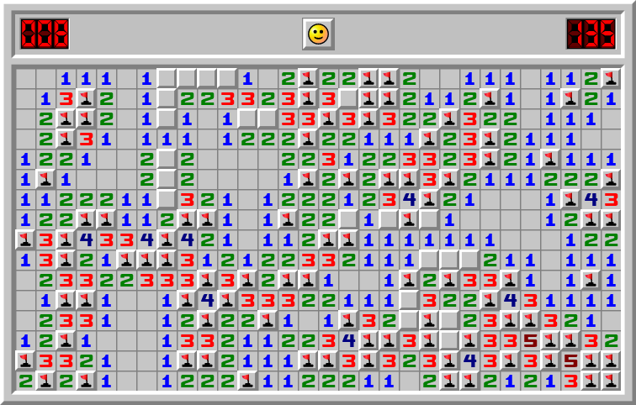

MinesweepeRL
Zăvoiu Andreea - 352
Voicu Bianca - 352
Dănilă Alexandra - 352
Tache Roxana - 333
Ene Sebastian - 352

Slide 2
Deep Reinforcement Learning in Video Games
Kun Shao, Zhentao Tang, Yuanheng Zhu, Nannan Li, Dongbin Zhao
Zăvoiu Andreea

Slide 3
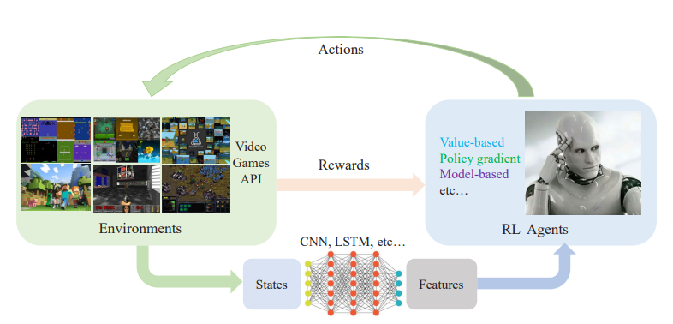
Introduction
DRL makes a combination of DL and RL, achieving rapid developments since proposed.
It has made great progress in video games, including Atari, ViZDoom, StarCraft, Dota2, Minecraft and so on.
Different DRL methods and their successful applications are introduced.

Slide 4
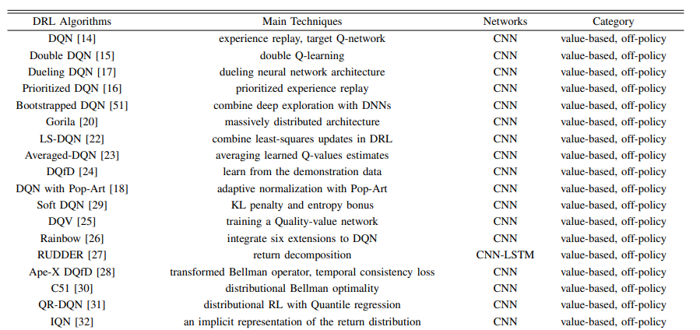
A GENERAL REVIEW OF RECENT DRL METHODS FROM 2017 TO 2018
A. Value-based DRL methods

Slide 5
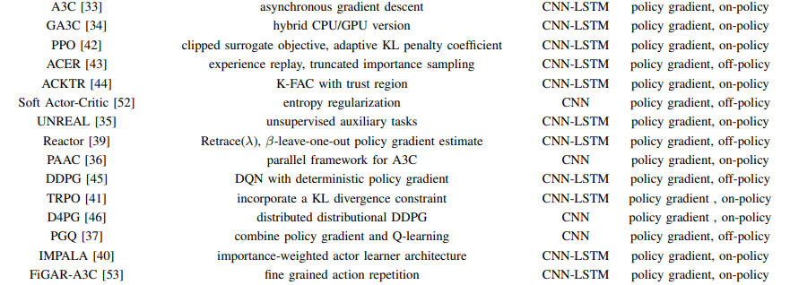
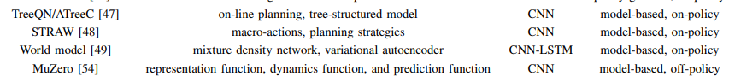
A GENERAL REVIEW OF RECENT DRL METHODS FROM 2017 TO 2018
B. Policy gradient DRL methods
C. Model-based DRL methods

Slide 6
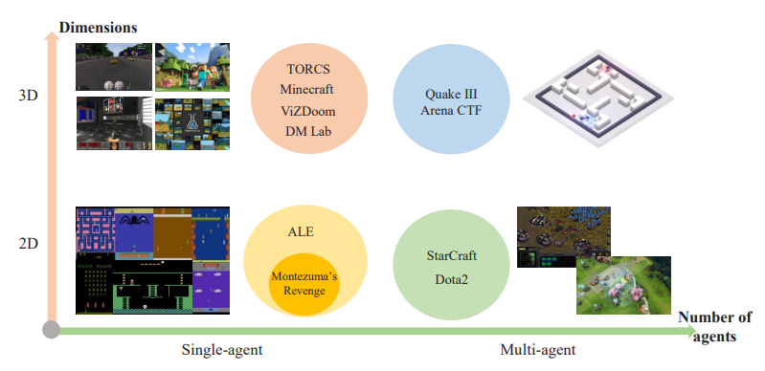
DRL IN VIDEO GAMES
Game research platforms
General Platforms
Specific Platforms

Slide 7
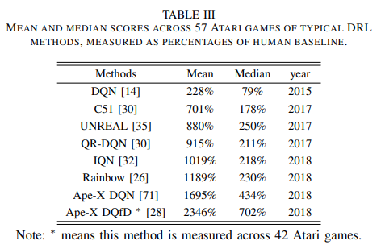
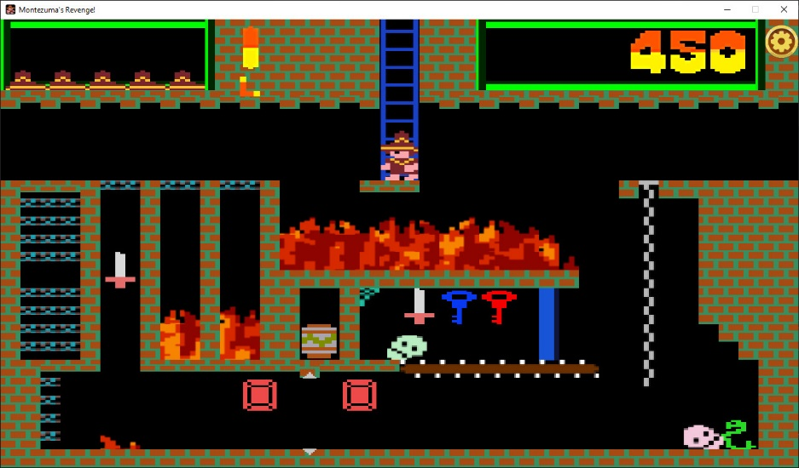
DRL IN VIDEO GAMES
B. Atari games
ALE is an evaluation platform that aims at building agents with general intelligence across hundreds of Atari 2600 games.
Montezuma’s Revenge

Slide 8
DRL IN VIDEO GAMES
C. First-person perspective games
VizDoom
TORCS
Minecraft
DeepMind lab
D. Real-time strategy (RTS) games
- StarCraft
- MOBA and Dota2

Slide 9
CHALLENGES IN GAMES WITH DRL
a. Exploration-exploitation
b. Sample efficiency
c. Generalization and Transfer
d. Multi-agent learning
e. Imperfect information
f. Delayed spare rewards

Slide 10
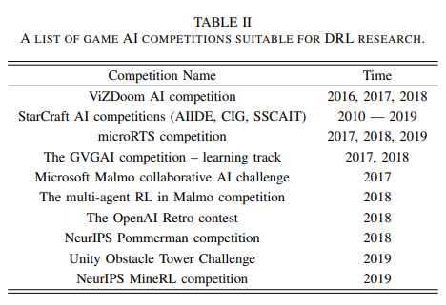
Conclusions paper 1
DRL for Game AI (both challenging and promising)
Recent progress →development of AI research
These DRL agents: human-level or super-human performance
In various games, 2D perfect information to 3D imperfect information,
Problems with DRL:
especially in 3D imperfect information multi-agent video game
requirements of more efficient and robust DRL techniques
needs of novel frameworks to be implemented in complex environments

Slide 11
Reinforcement Learning For Constraint Satisfaction Game Agents 15-Puzzle, 2048, and Sudoku
Anav Mehta
Cupertino, CA, USA
Voicu Bianca

Slide 12
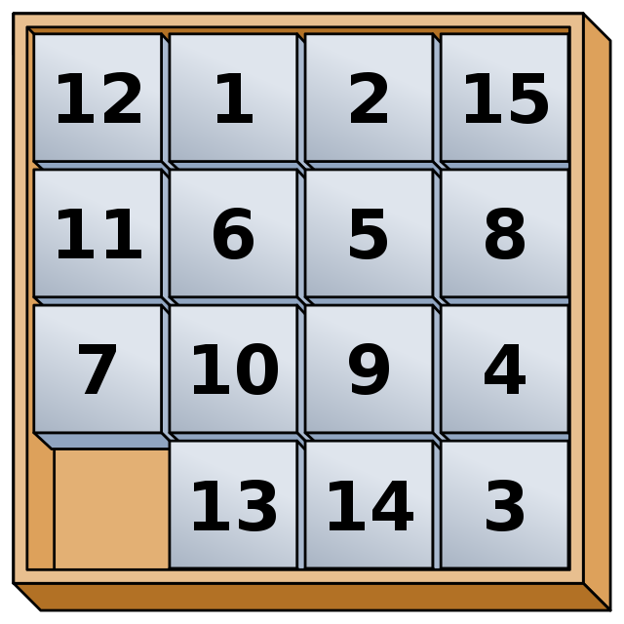
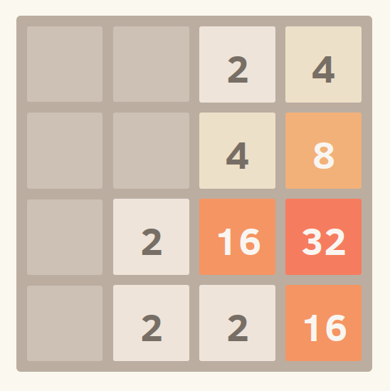
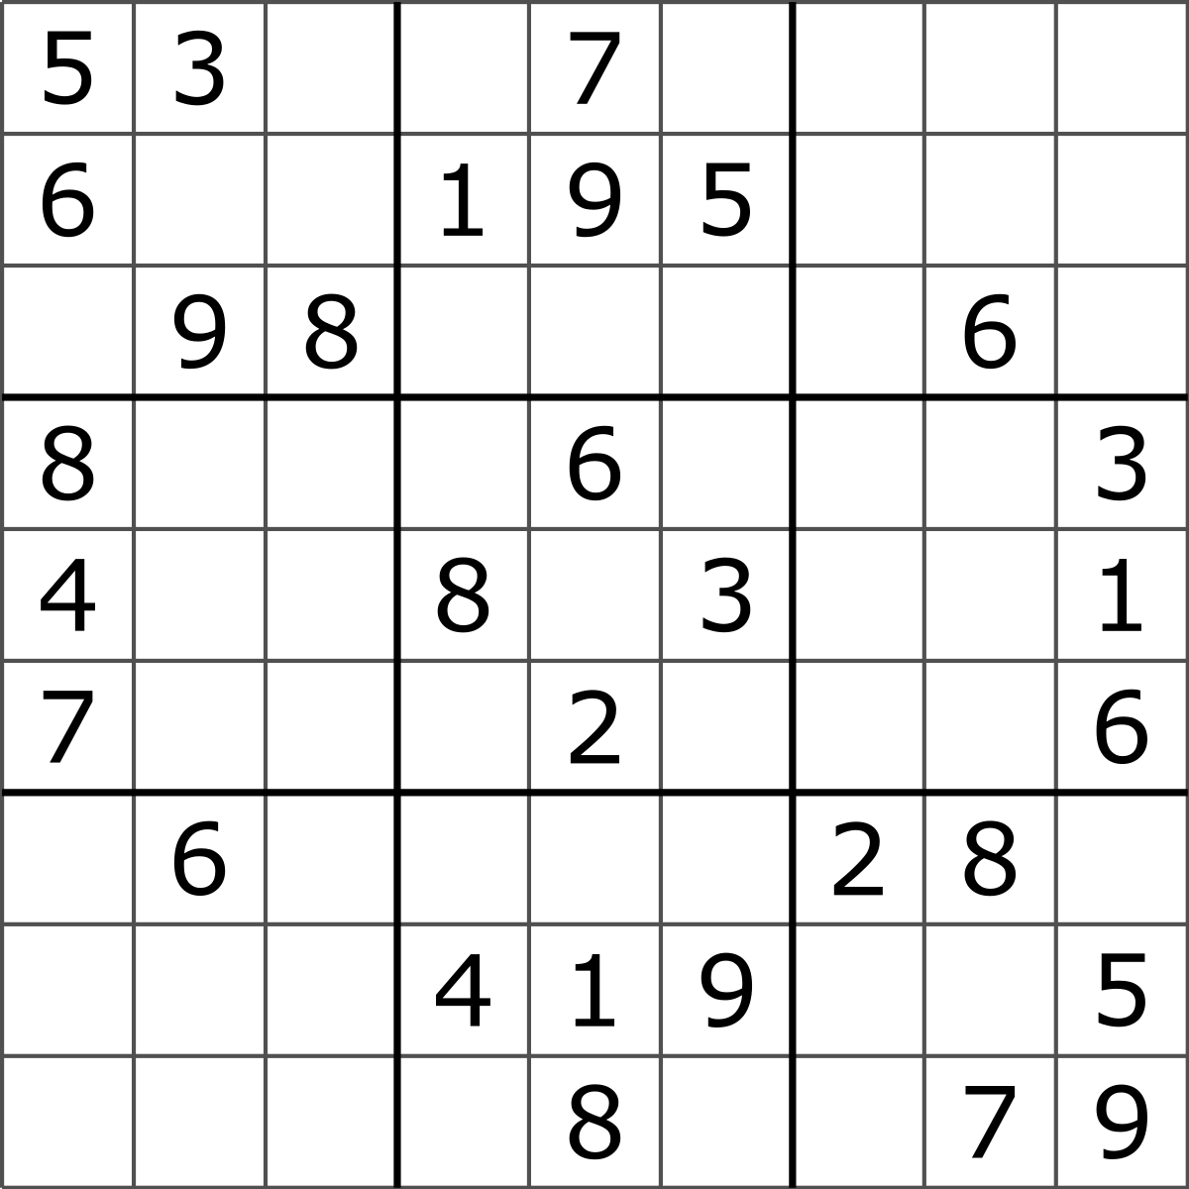
15-puzzle, 2048, Sudoku
Sudoku
15 Puzzle
2048

Slide 13
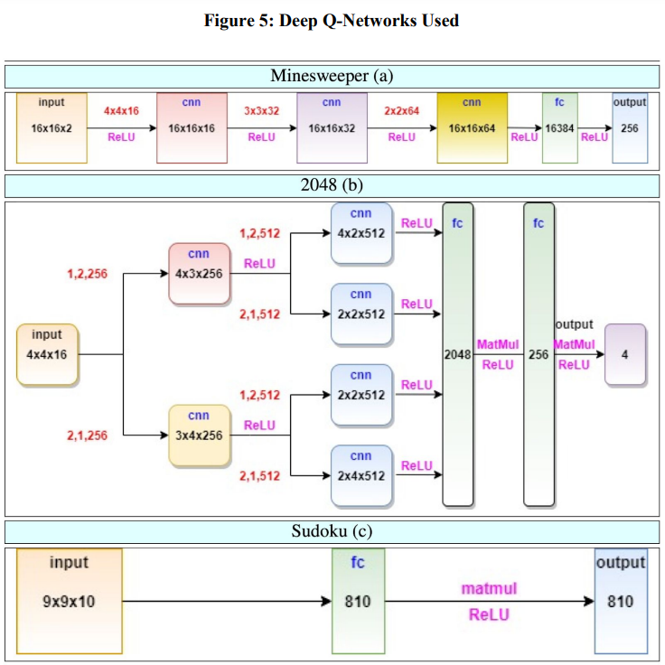
RL methods
optimum <-- agent<-- experience (a,r)
Rewards: sparse→NA policy gradients
q-learning methods
2 DQN

Slide 14
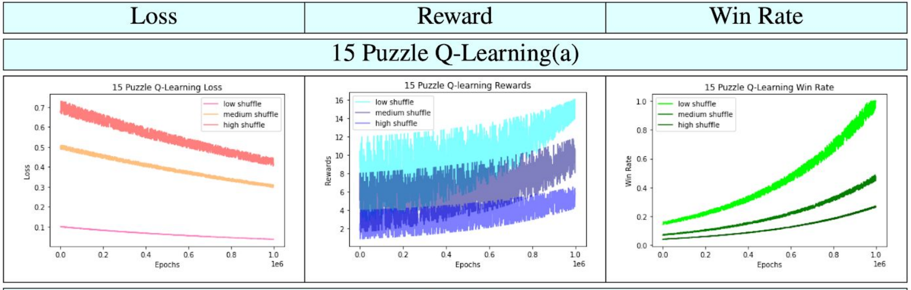
Experiments and Results – 15 Puzzle
Algorithm: Q-value iteration
The hyperparameters are:
learning_rate 𝛼 (set to 0.5)
discount_factor 𝛾 (set to 0.7)
epsilon-greedy 𝜖 (set to 0.1)
episodes (set to 1,000,000)
Win rates according to difficulty:
low shuffle games ➔ 100% win rate
medium shuffle games ➔ 43% win rate
high shuffle games ➔ 22% win rate

Slide 15
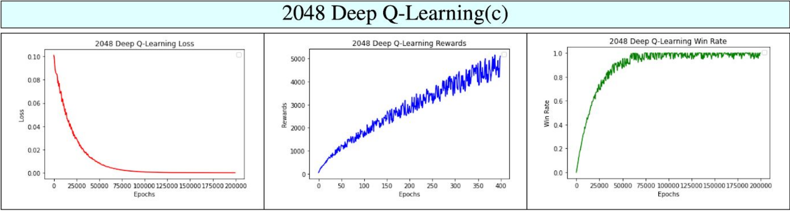
Experiments and Results - 2048
DQL algorithm suits well
The hyperparameters are:
learning_rate 𝛼 (set initially to 0.0005,
then 0.9* 𝛼)
discount_factor 𝛾 (set to 0.9)
epsilon_greedy 𝜖 (set to 0.9 and decreased
every 2500 iterations by 99.5%)
episodes (set to 200000)
buffer_Q, the experience buffer replay size (set to 100,000)
Win rates per stages of the game:
1024 ➔ 100% win rate (50,000 epochs )
2048 ➔ 40% win rate
4096 ➔ 0.05% win rate
8192 ➔ 0.01% win rate
16384 ➔ 0.004% win rate

Slide 16
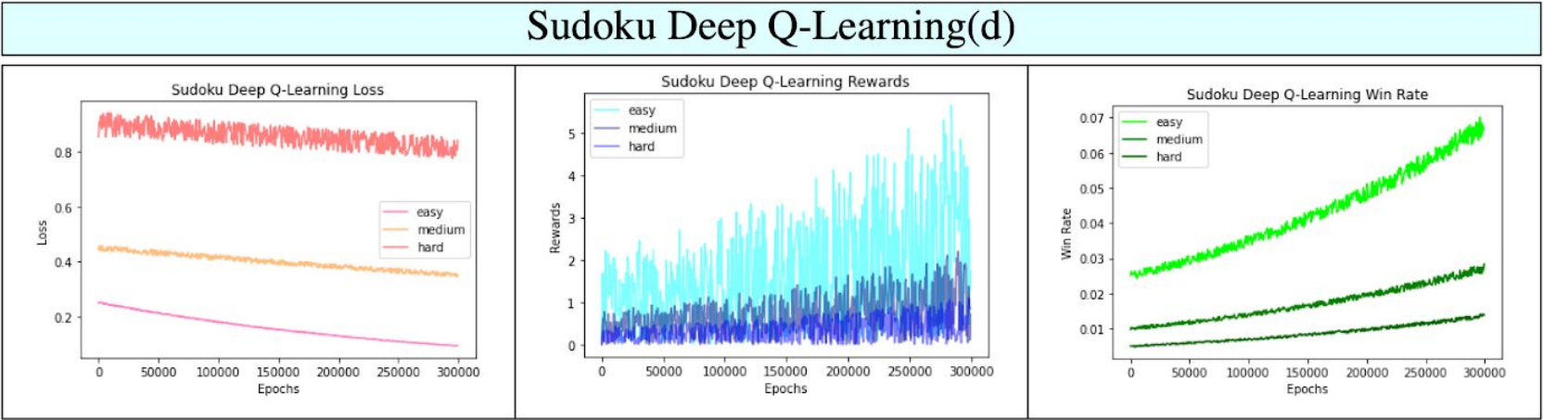
Experiments and Results - Sudoku
DQN here too
The hyperparameters are:
learning_rate 𝛼 (starts at 0.001 and decreases
by 1/10 and by 1/50)
discount_factor 𝛾 (set to 0.0)
epsilon_greedy 𝜖 (annealed from 1 to 0.1 over
300,000 iterations)
episodes (set to 300,000)
buffer_Q the experience buffer replay size (set to 100,000).
Win rates according to difficulty:
easy games ➔ 7% win rate
medium games ➔ 2.1% win rate
hard games ➔ 1.2% win rate

Slide 17

Conclusions paper 2
Q-learning and DQL
15-Puzzle, 2048, and Sudoku
The unique contribution is in choosing the reward structure, state representation, and formulation of the DQN.
Sudoku, high shuffle 15-Puzzle not high win rates
hyper-parameters were determined heuristically (extensive networks, loss is noisy)

Slide 18
Multi – Armed bandits for Minesweeper Profiting from Exploration – exploitation strategy
Igor Q. Lordeiro, Diego B. Haddad, IEEE member, and Douglas O. Cardoso
Dănilă Alexandra

Slide 19
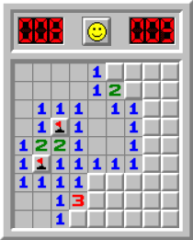
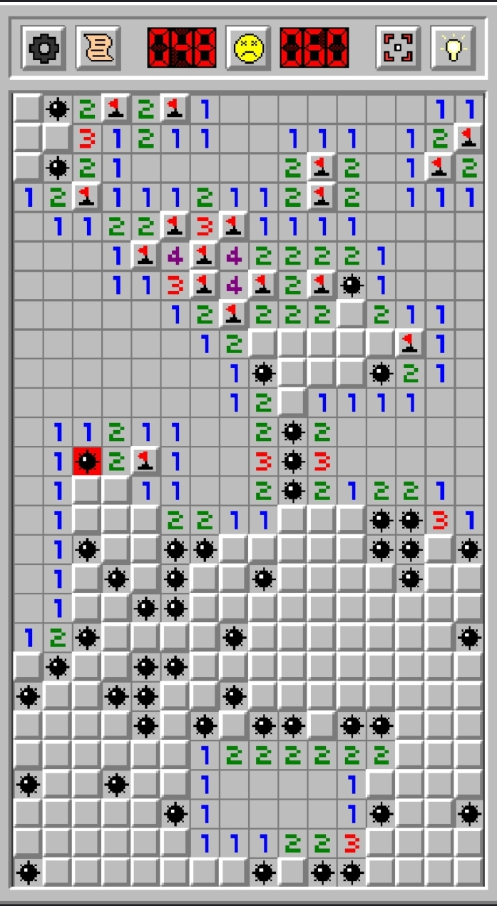
Minesweeper
Minesweeper is a single-player game.
It uses a board with m $×$ n tiles, which has k mines that are randomly placed on the board after the always-safe first click.
The purpose of the game is to find all of the tiles without any mine.
The theory of computation has placed the solution for this game in NP-completeness

Slide 20
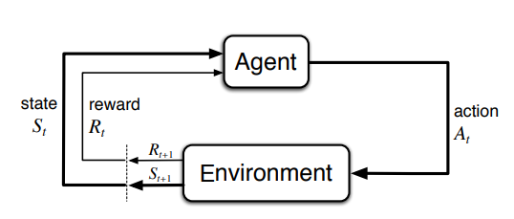
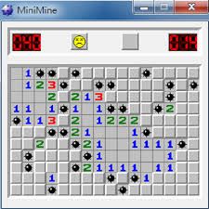
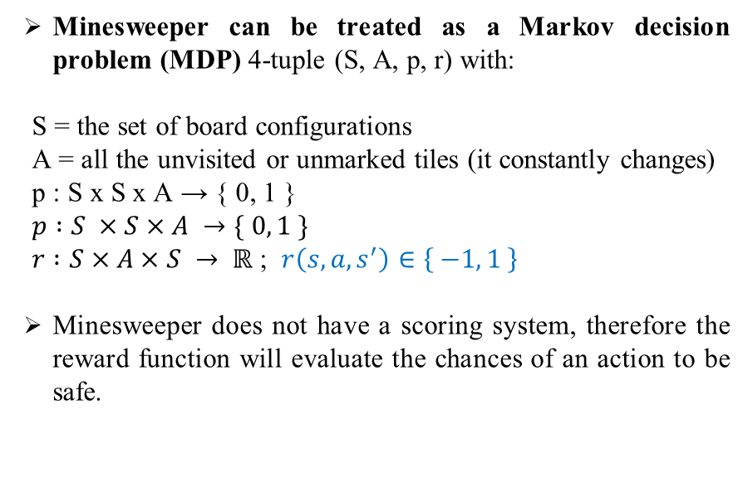
Approach and model choice
Minesweeper can be treated as a Markov decision problem (MDP) 4-tuple (S, A, p, r) with:
S = the set of board configurations
A = all the unvisited or unmarked tiles (it constantly changes)
p : S x S x A → { 0, 1 }
$p :S ×S×A →\{ 0, 1 \}$
$r :S×A×S → ℝ$ ; $r\left(s, a, s^{′}\right)∈\left\{ −1, 1 \right\}$
Minesweeper does not have a scoring system, therefore the reward function will evaluate the chances of an action to be safe.

Slide 21
MDP and Exploration – exploitation strategy
The exploration-exploitation trade-off refers to the tension between choosing actions that maximize the expected reward based on current knowledge (exploitation), and actions that gather information to improve future decisions (exploration)
In the explained MDP, exploration happens inevitably by always changing A.
Exploitation is enforced by exploration.

Slide 22
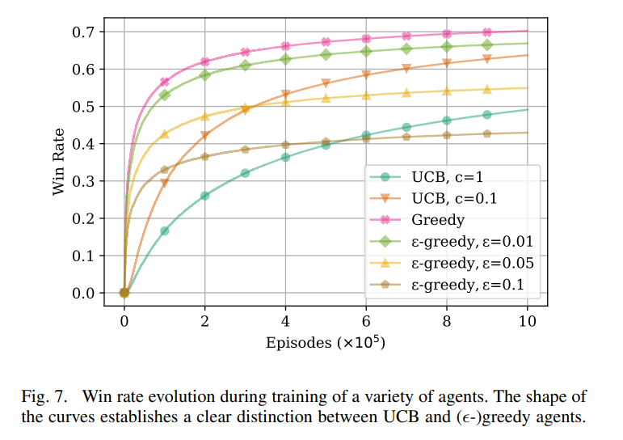
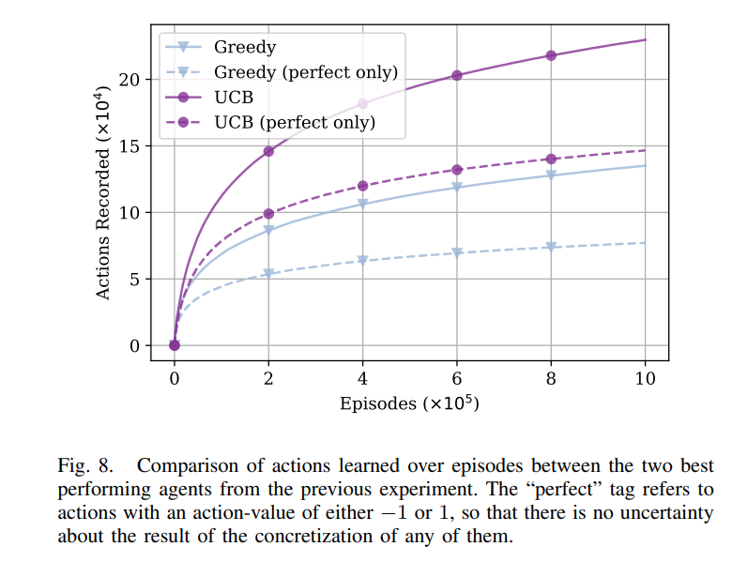
Multi-armed bandits; Experimental evaluation
UCB agent – calculate a confidence bound for each arm based on past observations, and choose the arm with the highest upper confidence bound, which balances exploitation and exploration.
Multi-armed bandits
algorithms
Greedy agent – simply choose the arm with the highest expected reward at each round, and only explore the other arms if the expected reward is not clear. Greedy algorithms are purely exploitation-based

Slide 23
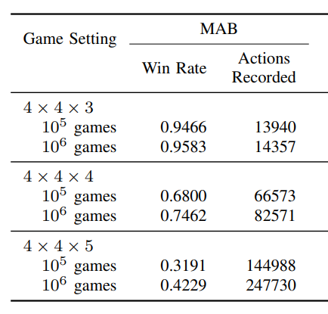
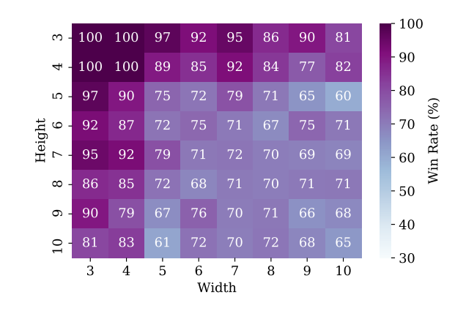
Conclusions paper 3
Results of using multi-armed bandits algorithms have resulted into high success rates for beginner-level and can be a prolific perspective for solving the game.
Table for win rates for MAB greedy agents
Heatmap displaying the win rate of greedy agents

Slide 24
Training a Minesweeper Solver
Luis Gardea, Griffin Koontz, Ryan Silva
CS 221, Autumn 2015
Tache Roxana-Maria 333

Slide 25
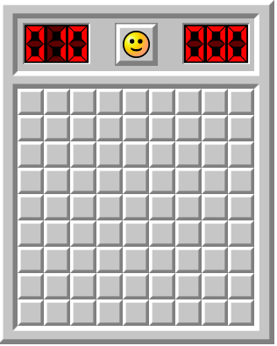
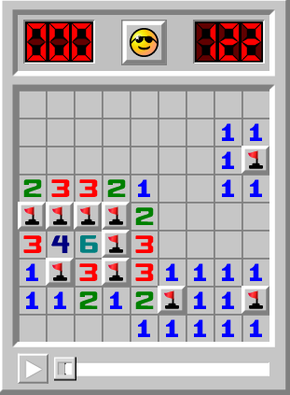
History of solvers
First solver => The „obvious” approach
Deep reinforcement learning
Neural network
Genetic algorithms, graphical models and other learning strategies
Unsolved board
Solved board
Source: https://minesweeper.online
Notes:
Minesweeper is a game that first appeats in the 1960’s, it’s purpose is to solve a grid puzzle with minimum information about the board. In the beginning the player is presented with a grid that has hidden squares, in the example below there are 10 hidden mines. The player must work with the information gathered during the play to reach the end.

Slide 26
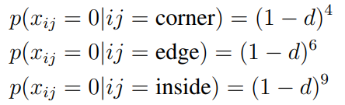
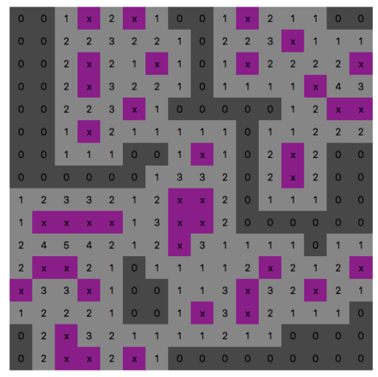
Approach to solve
The player cannot lose on the first move
Probability for clear squares
The board after markings
Notes:
Minesweeper is a game that first appeats in the 1960’s, it’s purpose is to solve a grid puzzle with minimum information about the board. In the beginning the player is presented with a grid that has hidden squares, in the example below there are 10 hidden mines. The player must work with the information gathered during the play to reach the end.

Slide 27
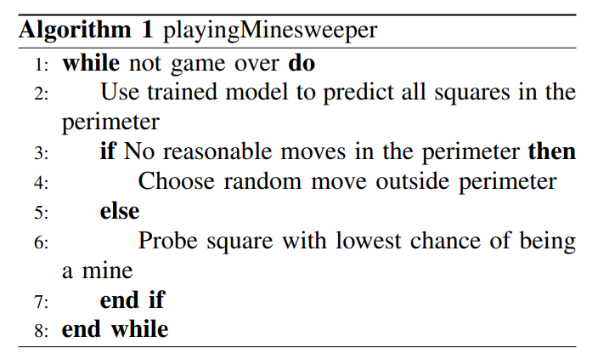
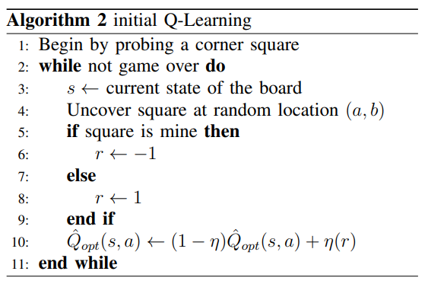
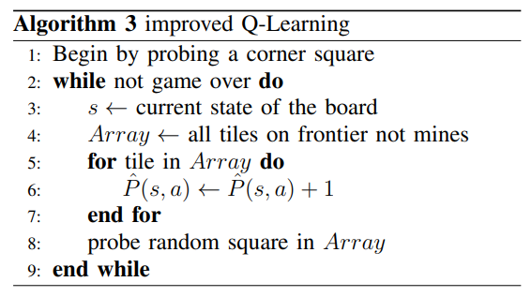

Slide 28
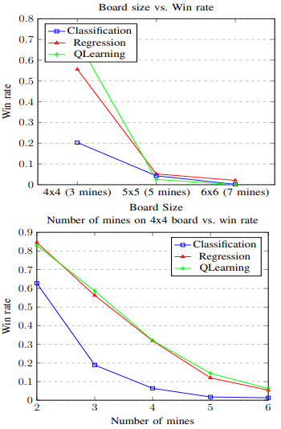
Results and analysis

Slide 29
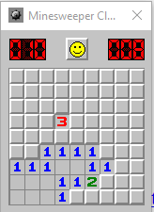
Minesweeper Classic Hands-On DQN
A practical implementation
Stephen Lee https://github.com/sdlee94/Minesweeper-AI-Reinforcement-Learning
Ene Sebastian

Slide 30




The journey Start → End
Start
Libraries installation (incompatibilities)
Minesweeper installation
||| Debugging below |||
| |
Minesweeper screen detection
Cells (unsolved /zero /one /…/six )
Emojis (still alive / loose /win )
| |
Save of training data+ long running time for train
| |
Detected Minesweeper, continuous play!!
Win emoji
Switched to Google Colab (DQN_train)
Variation of parameters
| |
||| grateful (help TA) |||
End

Slide 31
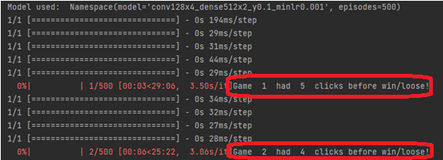
Our contributions (vs Github project)
made it run on PC on a different Minesweeper version
number of discovered cells per epoch
verbose (for console)
Automatic save of graphs with metrics
Automatic save of data (for graphs)
Heuristic tuning of parameters
Number of clicks before loosing/ (winning)

Slide 32
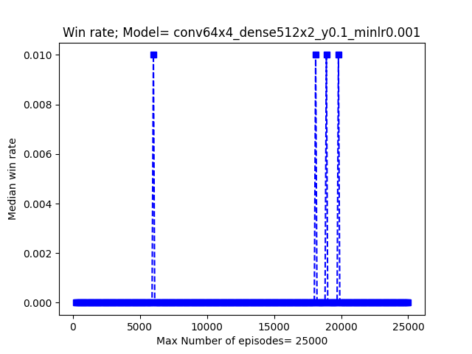
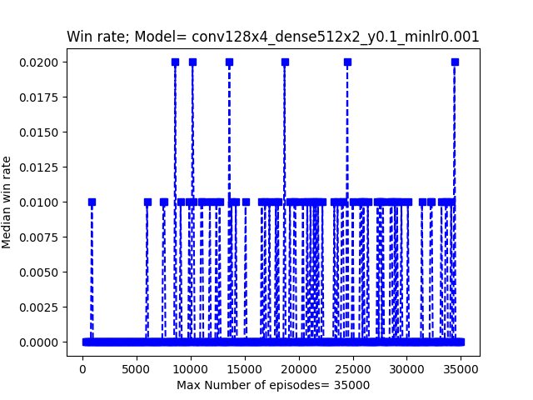
WIN Rate results 64 / 128 DQN neurons

Slide 33
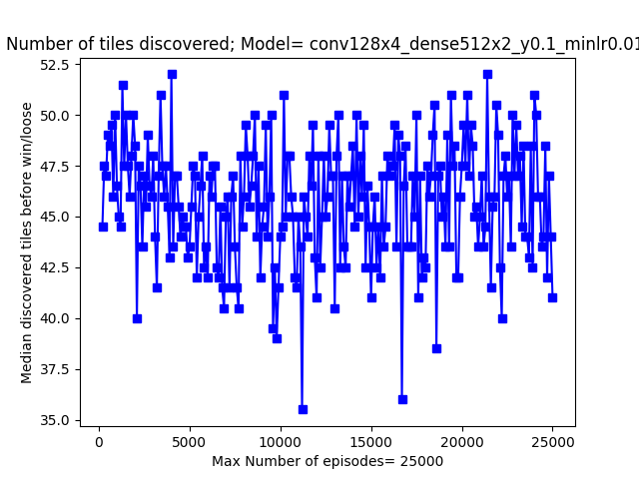
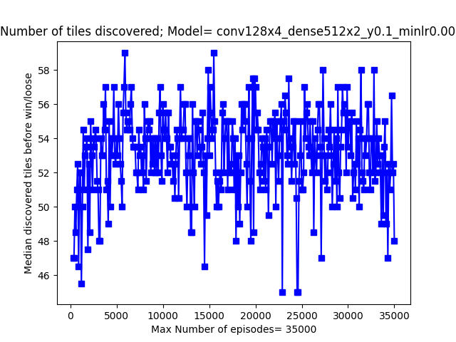
Discovered Tiles (128 neurons)

Slide 34
The conclusions hands-on project
Hands-on project
Coding and debugging
PC played game after game!
Some winnings!
(train time for a good agent in Minesweeper is ...)

Slide 35
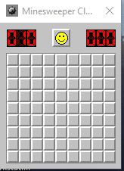


Questions/ live demo?
Our result

